Slide 1
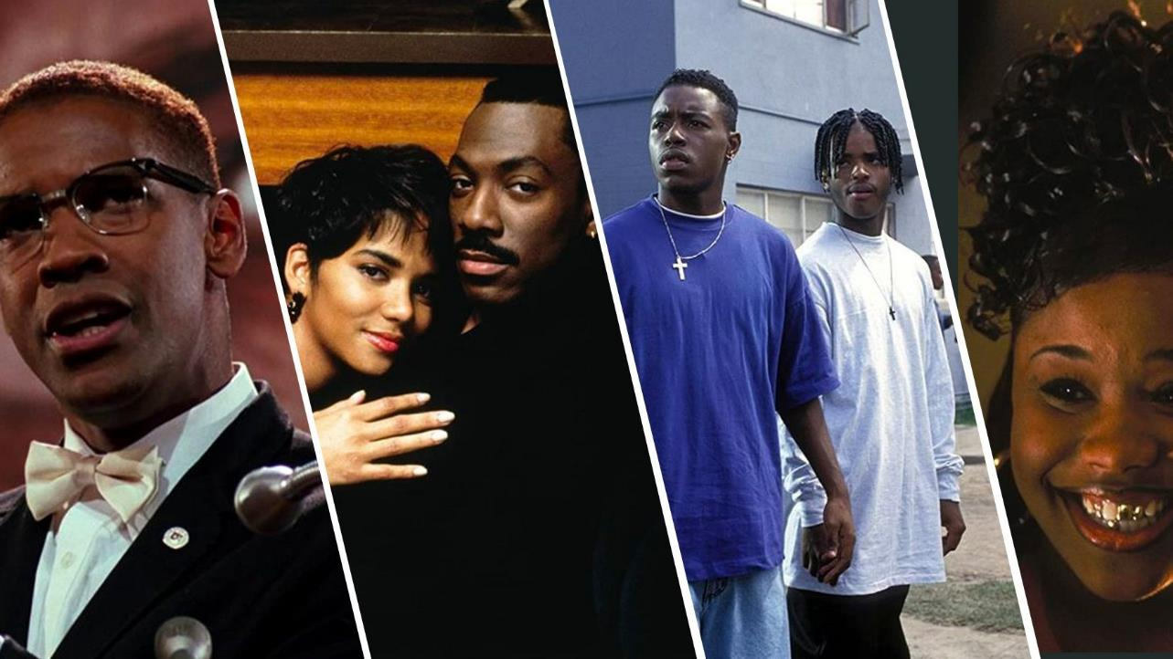
AFRICAN AMERICANS AND AMERICAN FILM

Slide 2
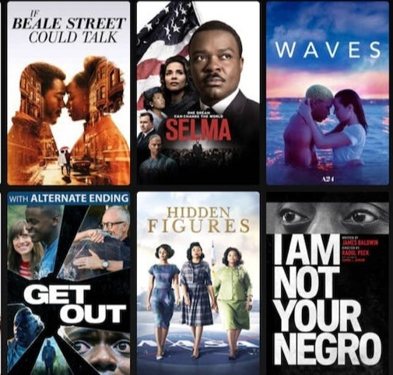
The Evolution of Black Representation in Film

Slide 3
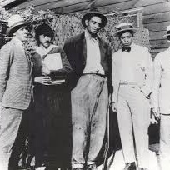
EARLY CINEMA AND REPRESENTATIONS OF BLACKNESS

Slide 4

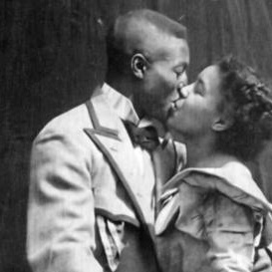
The Beginning of Black Cinema
1898: making of the short film Something Good – Negro Kiss. Showed an African-American man and woman sharing multiple kisses and marks the first known example of a positive romantic representation of a Black couple on film
Early commercial films often depicted minstrel shows until vaudeville acts overtook them in popularity.
1909: African Americans started to appear in narrative films, which is also the year that Siegmund Lubin produced the comedy series, using a Black cast, with the derogatory title Sambo. Before then, film roles for Black actors were played by white actors in blackface.
1914: Sam Lucas became the first Black actor to be cast in a leading role in a mainstream film, appearing in the 1914 film Uncle Tom's Cabin. The Peter P. Jones Film Company was established in Chicago and filmed vaudeville acts as well as the 1915 National Half Century Exposition and Lincoln Jubilee.
African-American attendance at movie theatres provided a unique opportunity for production companies to market films directly to African-American theaters for profit. William D. Foster was an African-American film producer who founded one of the earliest film studios featuring African-American talent — the Foster Photoplay Company. The Peter P. Jones Film Company and the Lincoln Motion Picture Company were two more production houses that specialized in films for African-American audiences.
1920s: REOL Productions, a New York City studio, produced films with actors from the Lafayette Players. During its relatively short existence REOL produced a couple of documentaries, comedies, and a feature film.

Slide 5
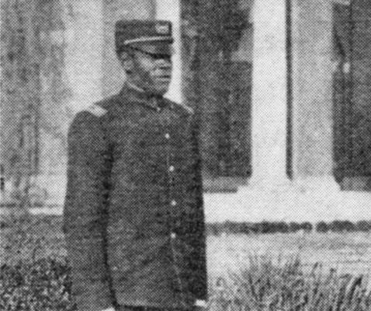
Uplift Cinema
The Uplift Movement, a concept that was created by Black elites like WEB Du Bois and Booker T. Washington, was meant to motivate educated African Americans to lift up their communities. Race films became a powerful tool for the movement, as Black filmmakers were able to use these movies to promote their message.
Under Washington’s leadership, Tuskegee Institute, an early Post Civil War teacher-training college in Alabama for newly freed slaves, produced several documentary shorts, as a way to promote the institute and build support among the school's benefactors. Their first promotional documentary was 1909's A Trip to Tuskegee (1909) followed in 1913 by A Day at Tuskegee. That same year, Samuel Chapman Armstrong's Post Civil War Hampton Institute, which focused on "manual labor and self-help," took a page from Washington's book and created its own narrative documentary John Henry at Hampton: A Kind of Student Who Makes Good, specifically to appeal to Northern donors.

Slide 6
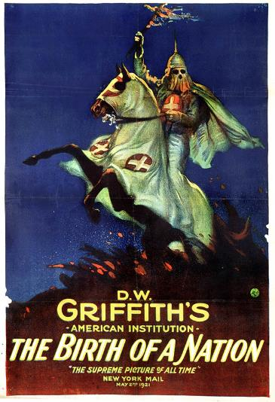
Birth of a Nation (1915)
D. W. Griffith’s Birth of a Nation (1915) is one of the first full-length feature films and the first film ever screened at the White House for then President Woodrow Wilson. However, the film contains many racist themes as well as inaccuracies in the portrayal of American history.
The film is set during and after the Civil War and, essentially, depicts the results of giving freed slaves and African Americans the right to vote and hold political office. Black men, played by white actors in blackface, are portrayed as power-hungry rapists and murderers, unfit for freedom. And when it seems all hope is lost for the white Southerners suffering under the “savagery” of reconstruction, it is The Ku Klux Klan that rides to the rescue. They are the hooded heroes who save the day, protecting whites from the menace of African Americans who have the audacity to want to vote. In fact, the original title of the film was The Clansman.
While the film had some immediate critics, most theatergoers, who were primarily white, loved the film, because it:
reaffirmed the contemporary, hegemonic idea of race in America
presented the subjugation of Black people to white people as the “natural order of things” by showing audiences the danger of upending that order.

Slide 7
Performing in Blackface
The next big milestone in cinema history was the introduction of synchronized sound in 1927 with the landmark film, The Jazz Singer, that set the world on fire and revolutionized how movies were made.
Actor Al Jolson plays the son of Jewish immigrants and spends a third of the film performing in blackface in front of a sold-out crowd of white people. White performers wearing blackface was a common form of popular entertainment at the time, a caricature of African Americans satirizing African American culture. By the 1930s, blackface began to fall out of favor, partly because enough African Americans protested its use in popular entertainment and partly because some white people began to see it as offensive and racist.

Slide 8
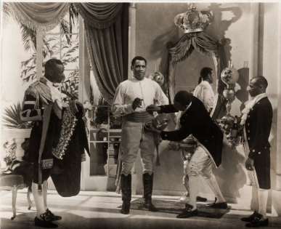
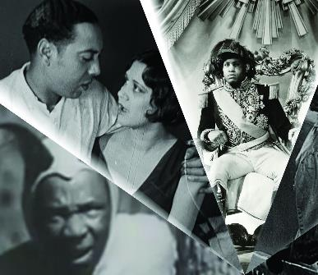
Race Films
The influential revival of Black arts and culture later, known as the Harlem Renaissance helped the film scene in African-American communities gain a lot more traction, particularly after “Birth of the Nation” as many African-Americans were outraged by the film, which led to the rise of Race Films.
Considered the First Golden Era for Black Cinema, Race Films were made explicitly for Black audiences using all-Black casts. The purpose of these films was to offer a counter-narrative to the racist portrayals of Black people that were made by white producers. These films provided honest portrayals and positive messages about the African-American community and gave Black audiences an opportunity to see films that better depicted them on the movie screen.
There were all kinds of race movies made. Some had storylines that uplifted the race. Some addressed “taboo” topics in the Black community. And some were movies made merely for pure entertainment like comedies, gangster films, and dramas. The most striking difference between race films and mainstream movies was that race films featured African-Americans actors in higher-quality movie roles that more fittingly reflected the race. The Race Film Era is of the most prolific times in Black cinema. It is estimated that over 500 race films were made during this historical era.
Most of the Race Films were shown in Black movie houses located in African-American neighborhoods. Many of these theaters had previously been used for Black vaudeville acts. When movies became popular, these theaters were converted into movie houses for African-American patrons.

Slide 9
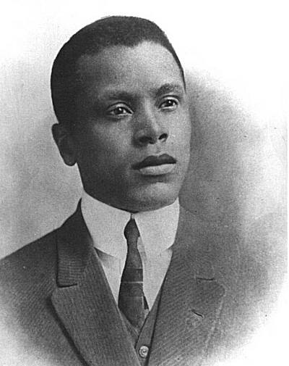
SPOTLIGHT: Oscar Micheaux, the First Black Filmmaker
Oscar Micheaux has been described as "the most successful African-American filmmaker of the first half of the 20th century“. Micheaux produced over 40 films, which drew audiences throughout the U.S. as well as internationally. In addition to writing and directing his own films, Micheaux also adapted the works of different writers for his silent pictures.
Published in 1913, his first novel The Conquest: The Story of a Negro Pioneer was loosely based on his own life as a homesteader and the failure of his marriage. The novel attracted attention from a film production company in Los Angeles, which offered to adapt the book into a film. Negotiations fell apart when Michaeux wanted to be directly involved in the film's production, and he decided to produce the film himself. The film, The Homesteader (1918) directly confronts the tragic mulatto stereotype by having the protagonist, an African American, fall in love and marry a woman who “passes” as white but is discovered to be of mixed race. A storyline that actually celebrates rather than denigrates the revelation of African heritage in someone presumed to be white.
He founded the Micheaux Film & Book Company of Sioux City and then formed The Micheaux Film Corporation in 1919. He produced the film Within Our Gates (1920) as a direct response to D. W. Griffith’s Birth of a Nation (1915). In that film, a white landowner attempts to rape a Black tenant until he realizes she is his own biological daughter. The revelation actually causes him to repent and turn away from his racist ideas.

Slide 10
Early Cinema Black-Owned Film Companies
Foster Photoplay Company: founded by William Foster in Chicago in 1910, he became the first African American to launch a movie studio. Foster wanted African Americans to control their narratives as many films with Black casts were owned by white studios and reinforced atrocious stereotypes promoting further disenfranchisement of marginalized Blacks.
Lincoln Motion Picture Company: founded in 1916 in Omaha, Nebraska by actor Noble Johnson and his brother George Johnson, before relocating to Los Angeles. The Johnsons were among the very first Black producers of African-American film and their company was the first to produce race movies. Their mission statement was to "encourage black pride“ with its "mostly family-oriented pictures. The company was short-lived due to lack of support from theaters and low sales and ended after producing 5 pictures. But, its legacy remained an inspiration for future Black movie studios to come.
Peter P. Jones Photoplay Company: founded in 1917. Films showed the progress of African Americans in the United States.
Early Cinema White-Owned Film Companies that featured Black Casts
Ebony Film Corporation: founded in 1915. The Chicago-based movie studio was considered to be one of the first companies to feature entirely Black casts in their motion pictures. Black audiences were turned off by many of the racial stereotypes exhibited in their films. This was coming off the heels of D.W. Griffith’s Birth of a Nation. When the studio’s reputation was compromised, the company responded by changing its name to Ebony Films and hiring a Black staff to run the show in 1917.
Norman Studios: founded in 1920 in Jacksonville, Florida. Produced drama films with African American casts, even though Norman, himself, was white. Between 1920 and 1928, however, he made a string of successful films, starring Black actors.

Slide 11
Black Stereotypes in Early American Cinema
Film scholars have identified five broad categories of Black stereotypes in early American cinema:
Uncle Tom and Mammy roles: the slave who seemed to actually enjoy life on the plantation.
The most infamous example of the Uncle Tom stereotype is James Baskett’s performance as Uncle Remus in Walt Disney’s Song of the South (1946), a film blatantly offensive in its portrayal of happy and devoted slaves.
Hattie McDaniel played the most famous version of the Mammy character, Scarlet O’Hara’s loyal slave in Gone with the Wind (1939), for which she won the Academy Award for Best Supporting Actress. In fact, she was the first African American to win an Oscar.
Coon: an ineffectual and lazy simpleton. Slow-witted and easily fooled, this role was often used as comic relief, a foil for white protagonists to ridicule.
Lincoln Perry played the most famous version of this stereotype as the recurring character, Stepin Fetchit. A dim-witted fool who was often billed as “The Laziest Man in the World,” his popularity would earn Perry the distinction of being the first African American actor to earn a million dollars.
Tragic Mulatto: a character of mixed-race ancestry who was inevitably doomed and would appear now and again, almost always as a female character.
In Imitation of Life (1934), Peola’s fair skin allows her to pass as white and she fervently rejects being identified as black.
The Black Buck: a hypermasculine and dangerous Black male.
You see it throughout Birth of a Nation but also in just about every film in the classical era depicting Black men as violent, unpredictable and overtly sexualized.

Slide 12
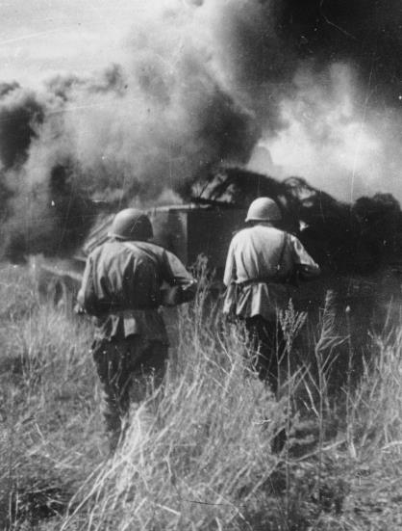
World War II
During WWII, many people in the U.S. felt the need to examine racism within our own country. Also, since much of the nation’s workforce had become part of the armed forces, home‐front industries began hiring both women and racial minorities. African Americans were encouraged by both Hollywood and the federal government to get involved in the war effort, most famously through a government‐produced documentary entitled The Negro Soldier (1943). This film was made for two main reasons: to explain to American blacks why they should fight, and to help eradicate racism in the ranks. The film was so popular that it crossed over into mainstream distribution.
In the documentary We've Come a Long, Long Way (1944), by white producer Jack Goldberg, Black people were warned that Hitler would outlaw the NAACP and suppress Black entertainers. In response, the NAACP launched a campaign against the film, calling it propaganda. However, there was also a belief in the Black community that fighting Hitler on behalf of America would help speed up the fight for their own rights.

Slide 13
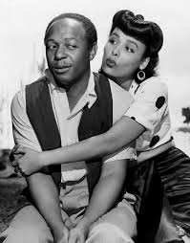
The Postwar Social Problem Film
After World War II, when African American involvement in the war effort began to turn public opinion against the enduring racism of the Jim Crow Era, Hollywood studios began incorporating more Black characters played by actual Black actors in an attempt to share in the profits of this untapped market. MGM produced Cabin in the Sky in 1943, the first musical with an all-Black cast by a major studio, and other studios followed suit. Yet, the narrative formula of most of these films is to deal with racial issues not from a black point of view, but from a white one. The characters themselves relied less and less on the tired, old stereotypes, but they were replaced by a new narrative that emphasized a passive acceptance of the status quo. Rarely were any of these roles centered around political engagement nor did they touch on the issues that were most important to the African American community.
For example:
Intruder in the Dust focuses on a white boy and his father more than on the black man around whom the story actually revolves. Even when the lead characters were African American, white actors sometimes played the parts.
Lost Boundaries is a film about light‐skinned black characters passing for white and the roles were played by white actors.
In Pinky, a light‐skinned black woman is played by white actress Jeanne Crain.
Hollywood obviously felt that this formula – dealing with racism from a white perspective – was necessary to draw in white audiences. The NAACP and other concerned groups petitioned Hollywood throughout the 1940s to make more diverse, less stereotypical representations of African Americans.

Slide 14
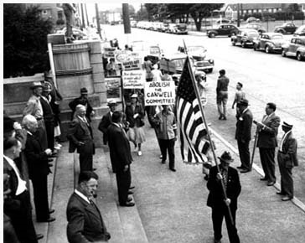
The Early 1950s
Soon those niche movie-houses showing lower-budget “race films” in African American communities could not compete with the grand studio-owned movie palaces screening big-budget spectacles featuring at least a few true-to-life African American characters, so many closed. In addition, film technology was changing, so the cost to produce them increased. For companies already operating on a tight budget, it became difficult to make a profit. and with nowhere to show their films, many of the filmmakers were forced out of the business. By 1950, Race Films had pretty much stopped being made.
The production of social problem films also waned in the early 1950s, partly because of the Red Scare and the McCarthy hearings during the Hollywood blacklist. Hollywood stopped making movies that suggested in any way that America was less than perfect and films about race or featuring African American stories were few and far between.

Slide 15
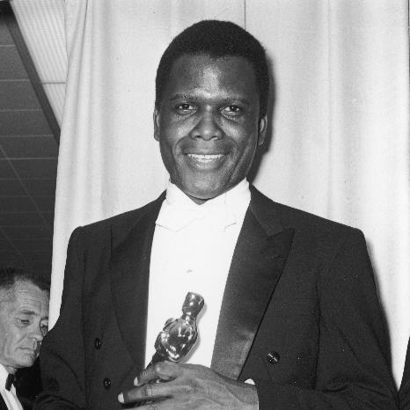
SPOTLIGHT: Sidney Poitier
During the 1950s, Sidney Poitier made groundbreaking waves in Hollywood. He was a trailblazer who entered the Hollywood scene with a film in 1950, where he played a doctor treating a White bigot. Soon after that came 1958, Poitier had already earned himself an Academy Award nomination for playing alongside Tony Curtis in The Defiant Ones.
The success of Poitier’s film career only continued into the 1960s. In 1963, Poitier became the first African-American to win an Oscar for Best Actor for his role in Lilies of the Field. Despite his many roles and awards, Poitier felt that Hollywood was using him as the token Black actor instead of actually pushing for diversity.
He was quickly typecast as the noble Black man without flaws which he accepted since it defied previous stereotypes. His films about acceptance and integration mirrored the Civil Rights movement at that time in which he was also an activist.

Slide 16
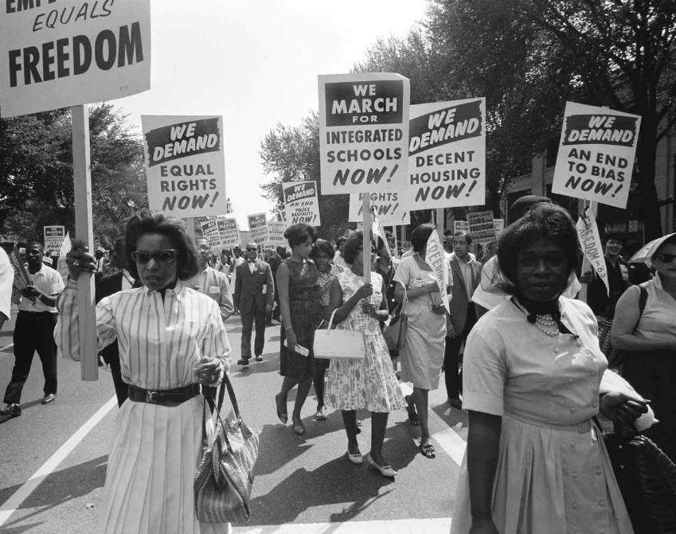
THE POST-CIVIL RIGHTS ERA

Slide 17
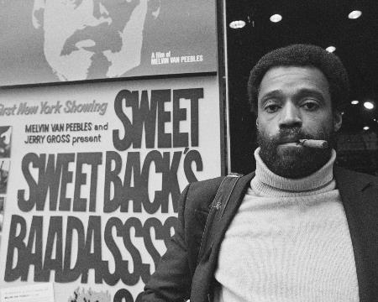
Reclaiming an Image of Black Culture and Masculinity
Despite the Civil Rights Act of 1964, many African Americans were frustrated by the lack of real change in the wake of the Civil Rights Movement and by the persistent image of African Americans as passive, often secondary characters in Hollywood cinema. So, African American filmmakers like Melvin Van Peebles and Gordon Parks started making their own, often independently financed films that reclaimed an image of Black culture, and Black masculinity in particular, as powerful, pro-active, anti-establishment, and yes, even dangerous. It was, in a way, a re-appropriation of the Hollywood stereotype of the aggressive, violent Black man, meant as a provocation to the cultural complacency of the post-Civil Rights era.
It all started with Melvin Van Peebles’ 1971 Sweet, Sweetback’s Baadasssss Song. The film stars Van Peebles as a successful gigolo in Los Angeles who finds himself on the wrong side of the law after stopping two white police officers from beating a defenseless young activist. On the run, he finds protection and support within the Black community as the (mostly white) authorities terrorize the city looking for him. It was low-budget and rough around the edges, but it depicted a strong Black male lead struggling against the forces of white power. It was, literally and metaphorically, revolutionary.

Slide 18
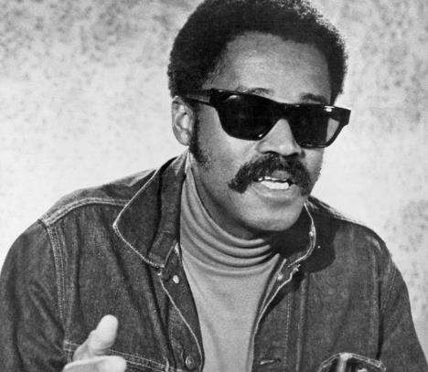
SPOTLIGHT: Melvin Van Peebles, The “Godfather” of Black Cinema
Van Peebles’ feature film debut, The Story of a Three-Day Pass (1967), won him an award at the San Francisco International Film Festival which gained him the interest of Hollywood studios, leading to his American feature debut Watermelon Man (1970). He continued to make films, write novels and stage plays in English and in French through the next several decades.
The success of his films helped open the door for other Black filmmakers, such as Spike Lee and John Singleton.

Slide 19
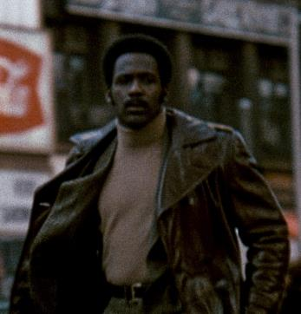
Blaxploitation
Hollywood saw the profits that Sweet, Sweetback’s Baadasssss Song was making and began to produce its own gritty films about urban black protagonists. These films collectively became known as blaxploitation films. Films including Shaft (1971) directed by Gordon Parks and Super Fly (1972) directed by his son, Gordon Parks Jr., along with dozens of others in the first half of the 1970s, often explored themes of crime, sex, drugs, racial tensions, fighting back against “the man,” and black American life and struggles of the time.
They were hugely popular, both inside and outside of African American communities. But not everyone was pleased. The NAACP coined the term “blaxploitation” as a criticism of the genre. They felt the depiction of African Americans in these films, particularly the hyper-masculine Black men, was simply reproducing old Hollywood stereotypes and, in turn, exploiting African American audiences. From the filmmakers point of view, that was missing the point. Their goal was to reclaim that image and turn it loose on white hegemony.
But as the popularity of the films grew, so did their profits, and with those profits, came increasing interest from white producers and Hollywood itself. By the late 1970s, the films had become a parody of themselves, often backed by white producers and directed by white directors. Suddenly, “blaxploitation” took on a new meaning, with white filmmakers reducing the characters intended to resist hegemony to the same tired, old stereotypes. By the end of the 70s, the short-lived resurrection of Black Cinema in the form of blaxploitation was over.

Slide 20
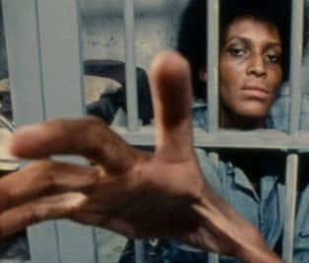
L.A. Rebellion
The late 1960s was a time of enormous political and social upheaval in the United States. Yet the struggles of these turbulent years were as much about culture as confrontation. Two years after the Watts Uprising, a landmark commemoration in August 1967 brought a surge of Black music, poetry, and visual art to the South Los Angeles area.
Following unrest from a 1969 shoot-out on the UCLA campus, several students at UCLA persuaded the university to launch an ethnographic studies programme responsive to local communities of color. As part of the Ethno-Communications initiative, a group of African and African-American students entered UCLA’s School of Theater, Film and Television and formed the "L.A. Rebellion.
This vital group of filmmakers shared a utopian vision of a better society and their goal was to create authentic narratives about the black experience that avoided the stereotypes of Hollywood and blaxploitation. Their films show: a sensitivity to children and gender issues, a willingness to question any and all received wisdom, their identification with the liberation movements in the Third World, and their expression of Black pride and dignity.
The films were influenced by study of “third world” cinema from Latin America and Africa, the French New Wave, and postwar neorealist cinema. The filmmakers, which also included Chicano and Asian students, brought to their work a wider consciousness of the black liberation and anti-Vietnam War movements and second-generation feminism. The results were classics such as Daughters of the Dust (1991), the first feature film directed by an African-American woman to receive a major theatrical release.
The L.A. Rebellion filmmakers created a unique cinematic landscape and over the course of two decades, as new students arrived, current students mentored them, passing the torch on to the next group and the next.

Slide 21
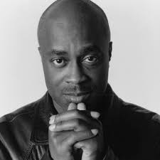
SPOTLIGHT: Charles Burnett, The “Godfather” of the L.A. Rebellion
His first feature film, Killer of Sheep (1977), which depicts the problems confronting working class African Americans in South Central, CA, was hailed as “an American masterpiece”. The film shared first prize at the Sundance Film Festival and was awarded a top prize at the Berlin International Film Festival. The narrative and documentary films that followed form a body of work that many critics believe offers the richest and most expansive exploration of African American culture and history of any filmmaker of Burnett’s generation.
Burnett is the recipient of numerous awards and honors, including MacArthur, Rockefeller, and Guggenheim fellowships, as well as the Horton Foote Screenwriting Award. Selected honors also include a Golden Thumb Award from the Roger Ebert Film Festival; Career Achievement Award from the Chicago International Film Festival; Paul Robeson Award from Howard University; Best Screenplay Award for To Sleep with Anger, from the National Society of Film Critics; the American Film Institute’s Maya Deren Award and the 2017 Governor’s Award from the Academy of Motion Picture Arts and Sciences.

Slide 22
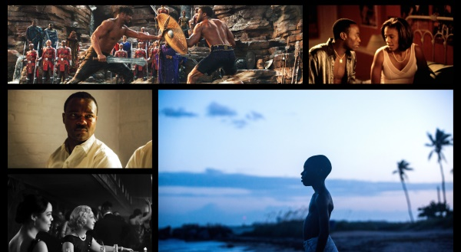
MODERN CINEMA AND REPRESENTATIONS OF BLACKNESS

Slide 23
Emergence of New Stereotypes
Moving into the modern era, a few new stereotypes emerged that were designed to promote a similar agenda.
The Magical Negro: usually a male with mysterious, supernatural powers whose only role is help the white protagonist achieve their goal and/or avoid some terrible predicament. Rarely has any inner life of their own, no motivations aside from helping the white characters.
The Thug: an updated version of the old “dangerous Black male” stereotype of early cinema. The Thug stereotype is arguably the most common of the new/old stereotypes.
The Sapphire: an angry black woman defined by her unmotivated aggression and little else
The Domestic: the Mammy role for the modern era
The Sassy Best Friend: offers sympathy to the white protagonist, then cracks an outrageous joke. Never has problems of their own.
What all of these modern stereotypes have in common is their role in shaping a shared cultural narrative about race in America. A narrative that constantly reaffirms whiteness as normative, and the implied value in any non-white “Other” submitting (or “assimilating”) to that norm.

Slide 24
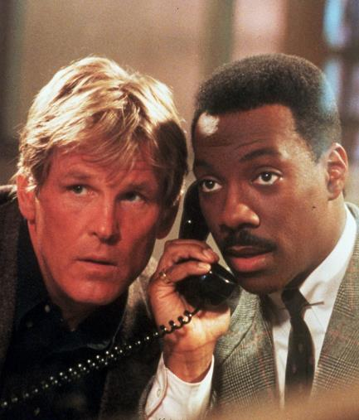
1980s Comedies
When the 1980s came around, cinema was produced that resisted real cultural change in terms of racial equality by emphasizing an anti-reactionary, assimilationist narrative. This narrative shows up in buddy comedies like Stir Crazy (1980), 48 Hrs. (1982) and the Lethal Weapon franchise which began in 1992. In each of those films, two characters, one Black and one white, must overcome their differences and work together. While an admirable message, it often ignored the deep disparities in power and opportunity between the two characters. Or if they did pay any attention to such issues, they played them as a joke.
Eddie Murphy was a breakout star. Eddie Murphy first gained attention in the early 1980s by being cast on Saturday Night Live. Murphy made his debut on the big screen in 48hrs (1982). Two years later, he left Saturday Night Live to pursue a career as an actor. He starred in many comedy hits like Beverly Hills Cop (1984), Coming To America (1988), and Harlem Knights (1989).
In 1987, Robert Townsend made his directorial debut with the film Hollywood Shuffle (1987) — a satirical take on how African-Americans have been portrayed in Hollywood.

Slide 25
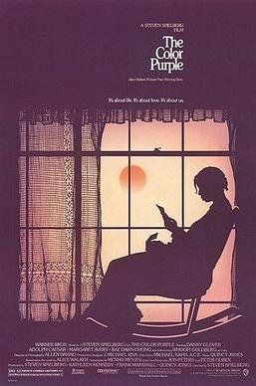
The Color Purple
Probably the most important (and controversial) 1980s Hollywood film about the African American experience was The Color Purple (1985), directed by Steven Spielberg. The film was based on Alice Walker’s Pulitzer prize‐winning novel about black women struggling for survival in the South during the first decades of the twentieth century. Much of their struggle was against the black men in their lives, who abused them in physical, sexual, and psychological ways.
When the film was released, there were predictable complaints about why it had been directed by a white man, but the largest controversy centered on the film’s alleged “male bashing.” Reiterating the arguments made in earlier decades, some critics and audiences felt the film was demeaning because while it celebrated black women, it also depicted African American men as rapists and abusers. The film did diminish many of the novel’s more important points. For example, the novel makes it clearer than does the film that black men abuse black women as part of a “chain of oppression” that stems in the first place from white brutality. The novel also deals centrally with a lesbian relationship between characters Shug and Celie, an important aspect of the book’s feminist project that was reduced to several chaste kisses in the movie.

Slide 26
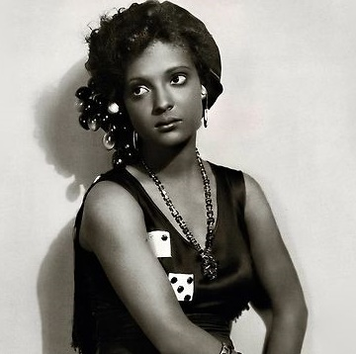
Independent Film Movement
An independent film movement emerged in the 1980s when more and more filmmakers had access to cheaper and cheaper equipment and were able to take control over the creative process outside of the Hollywood system.
Spike Lee, whose first feature film She’s Gotta Have it (1986) was shot in 12 days for just $175,000.
Robert Townsend’s Hollywood Shuffle (1987) was financed by maxing out his own credit cards.
Cheryl Dune and Julie Dash centered their films around the Black female experience.
A range of dramas and comedies with Black casts made it to theaters and gave audiences around the world a different perspective of African-American culture.

Slide 27
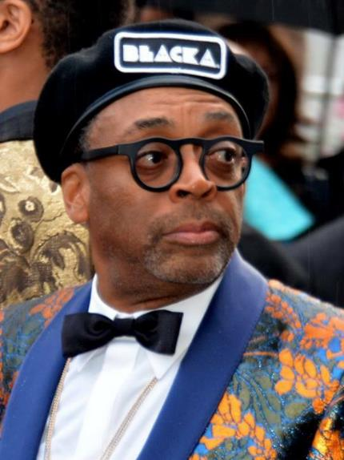
SPOTLIGHT: Spike Lee
Spike Lee paved the way for other African American filmmakers. His production company, 40 Acres and a Mule Filmworks, has produced more than 35 films since 1983. Lee’s work has continually explored race relations, issues within the black community, the role of media in contemporary life, urban crime and poverty, and other political issues.
His third film, Do the Right Thing (1989), unapologetically challenges white hegemony and takes on the cultural politics of race and directly comments on the issue of representation, racial inequality, gentrification and police brutality.
Lee has won numerous accolades for his work, including an Academy Award, two Primetime Emmy Awards, a BAFTA Award, and two Peabody Awards. He has also been honored with an Honorary BAFTA Award in 2002, an Honorary César in 2003, and the Academy Honorary Award in 2015.

Slide 28
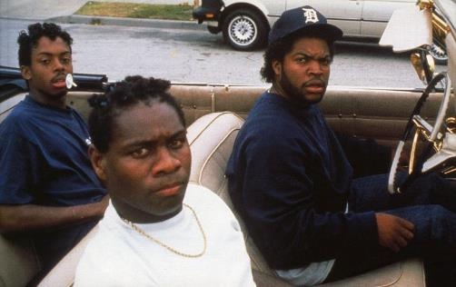
Young African American Filmmakers in the 1990s
A lot of young African American filmmakers were inspired by Spike Lee.
John Singleton would make Boyz n the Hood in 1991, a raw, nuanced portrait of teenage life in South Central Los Angeles and he would go on to become the first African-American to be nominated for an Academy Award for Best Director.
The Hughes brother would make Menace II Society in 1993.
F. Gary Gray would make Friday in 1995 and Set if Off in 1996.
Kasi Lemmons would make Eve’s Bayou in 1997.
All of them created work that echoed the counternarratives of Oscar Micheaux and Melvin Van Peebles, a new Black Cinema that let African American audiences know they too existed. They also let aspiring filmmakers know they could join the conversation.

Slide 29
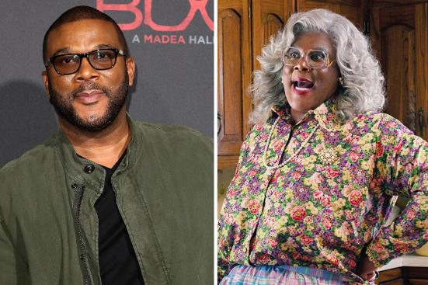
Tyler Perry and the 2000s
From the 2000s on, Black filmmakers have gained even greater recognition in Hollywood but the process was slow. The Black talent in front of the camera progressed at a faster rate than the talent behind the camera. African-American filmmakers started out confined to making mid-budget movies that rarely broke through to the mainstream audience.
Tyler Perry began his journey as a filmmaker in the early 2000s and he found success making films mostly targeting African-American audiences. Critics loathed his films but they were box-office successes. Hollywood often kept African-American actors and filmmakers to stories of oppression and historical traumas, which although it gained recognition from award shows, was severely limiting.

Slide 30
Present Day
The 2010s saw a new breakthrough in Black cinema where African-American filmmakers were finally given the opportunity to tell a diverse range of stories that were well-received by audiences. With streaming services and indie film companies growing exponentially, Black auteurs have ushered in a new era of Black cinema that is getting more seen, respected, and celebrated around the world every year.
Barry Jenkins - first film Medicine for Melancholy (2008) was a small, intimate romantic drama. His second film, Moonlight (2016), won the Academy Award for Best Picture.
Ava DuVernay - film Middle of Nowhere (2012) dramatized the toll of unequal incarceration rates among Black men. Two years later, she made Selma (2014), a historical drama about the civil rights march from Selma to Montgomery in 1965, for Paramount Pictures. A few years later, she helmed the $200 million Disney film A Wrinkle in Time (2018), becoming the first African-American woman to direct a film with a budget of $100 million.
Ryan Coogler - first film Fruitvale Station (2013) was a searing portrait of the last day in the life of Oscar Grant, the young, unarmed Black man shot dead by police in Oakland in 2009. His second film, Creed (2015) was a $40 million re-boot of the Rocky franchise, this time with an African American in the lead role. His third film, Black Panther (2018) was part of the Marvel series of films with a budget of more than $200 million, and the film grossed $1.3 billion worldwide.
All of these filmmakers, and many more, are not only offering an important counternarrative to modern audiences, they are affecting real change in the dominant narrative as well. And changing the narrative can mean, hopefully, a slow but steady dismantling of hegemony. Or, at the very least, remind audiences that African Americans do, in fact, exist outside of the roles that were written for them.

Slide 31
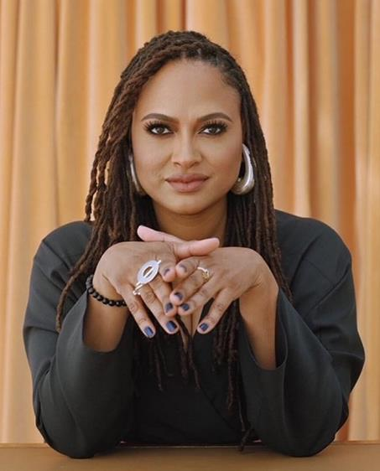
SPOTLIGHT: Ava Duvernay
Her films represent the fracturing of the black family structure, the trauma of history on the black family unit, black womanhood, mass incarceration, good over evil and fighting for justice. In addition, her films often seek to invert the tradition of the dehumanization of black people and the black body in the media.
She won the directing award in the U.S. dramatic competition at the 2012 Sundance Film Festival for her second feature film Middle of Nowhere (2012) becoming the first black woman to win the award. She is also a recipient of a Primetime Emmy Award, two NAACP Image Award, a BAFTA Film Award, and a BAFTA TV Award, as well as a nominee of an Academy Award for her documentary 13th (2016) and the first African-American woman to be nominated for a Golden Globe Award for Best Director for Selma (2014).
In 2011, she founded her independent distribution company ARRAY. In 2017, DuVernay was included on the annual Time Magazine’s 100 list of the most influential people in the world. In 2020, she was elected to the Academy of Motion Pictures Arts and Sciences board of governors as part of the directors branch.

Slide 32
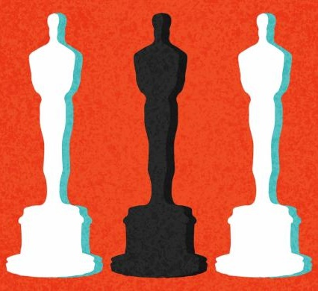
#OscarsSoWhite Campaign
Within the last decade, there has been an increasingly vocal critique of the Academy Awards and their persistent exclusion of African American actors from nominations and awards. Beginning in 2015, the #OscarsSoWhite campaign called on the Motion Picture Academy to redress this disparity after all 20 acting nominations went to white actors that year (and the year after that). And when African American actors have won major awards, it is often for playing the very roles that affirm white hegemony.
Denzel Washington was only the second African American to win a Best Actor Oscar in 2002 for playing the corrupt, “Thug” cop in Training Day (2001).
Halle Berry was the first African American in Oscar history to win Best Actress in that same year. It was for Monster’s Ball (2001) in which she played the widow of a death row inmate who has a torrid affair with her late husband’s white prison guard.

Slide 33
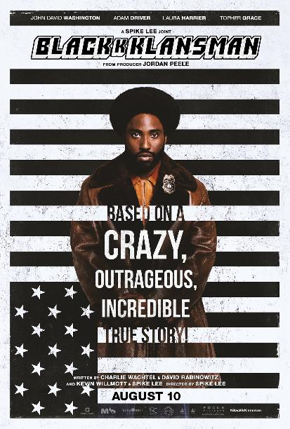
BlacKkKlansman (Spike Lee, 2018, USA)
CASE STUDY
Synopsis: Ron Stallworth is the first African-American detective to serve in the Colorado Springs Police Department. Determined to make a name for himself, Stallworth bravely sets out on a dangerous mission: infiltrate and expose the Ku Klux Klan. The detective soon recruits a more seasoned colleague, Flip Zimmerman, into the undercover investigation of a lifetime. Together, they team up to take down the extremist hate group as the organization aims to sanitize its rhetoric to appeal to the mainstream.

